Slide 1
Yet Another Neural Network Intro (YANNI)
Or is it laurel?
By Michael Santacroce

Slide 2
What will we talk about today?
How do neural nets work?
Interactive: how can I get started with neural nets?
Note: if you have learned about nets before, pay attention – I’ll have questions for you!
Resources (what I learned with):
http://neuralnetworksanddeeplearning.com/index.html (free ebook)
http://www.iro.umontreal.ca/~pift6266/H10/notes/mlintro.html (more math heavy. Note Theano is dead)
Intelligent Systems, Intelligent Data Analysis, Deep Learning, Machine Learning…

Slide 3
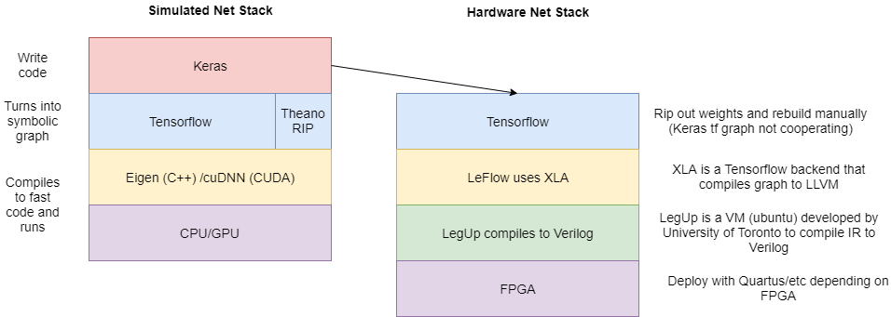
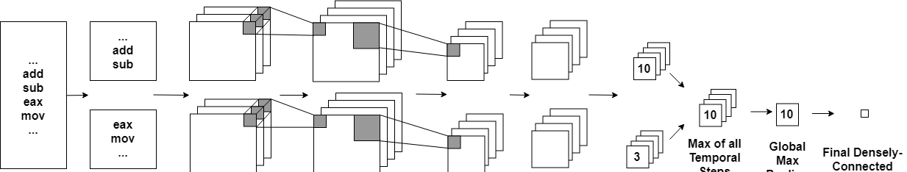
Who am I?
5th year ACCEND MSc CompE and BS CompE
Thesis: Neural Networks for malware detection
Goal is to create a malware-detecting model and deploy it to FPGA
I enjoy applied mathematics and neural nets are just that!

Slide 4

Why is it important to know how NNs work?
Neural networks are not a plug-and-chug solution to any problem
Poor understanding of the fundamentals leads to:
Inefficient designs that waste time and resources
Models that say they work but really don’t
Media claiming that Zuckerburg has made artificial consciousness
Embarrassing yourself in front of your friends
Neural network math is more than boring algebra and memorization!

Slide 5
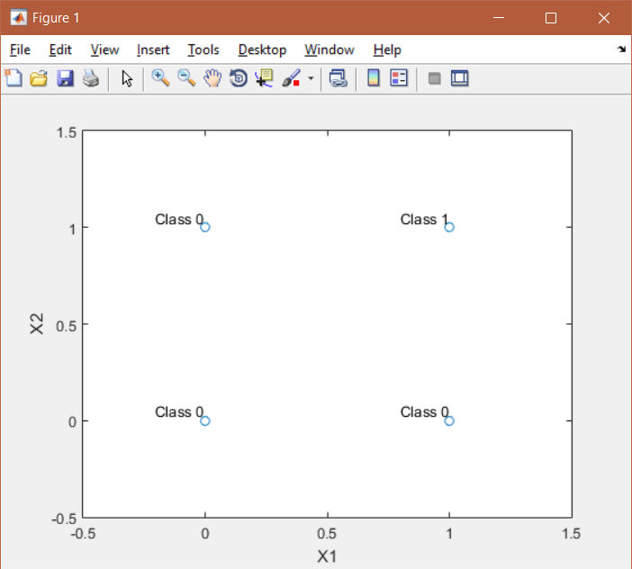
How do neural networks work?
Consider the following problem:
Two inputs, X1 and X2, with class labels
How can we make a function that returns 1 for class 1 and 0 for class 0?
(all plots made with matlab)

Slide 6
AND Problem
Let’s think about one step at a time:
What is the simplest way to separate the space that contains class one and the space that separates class two?

Slide 7
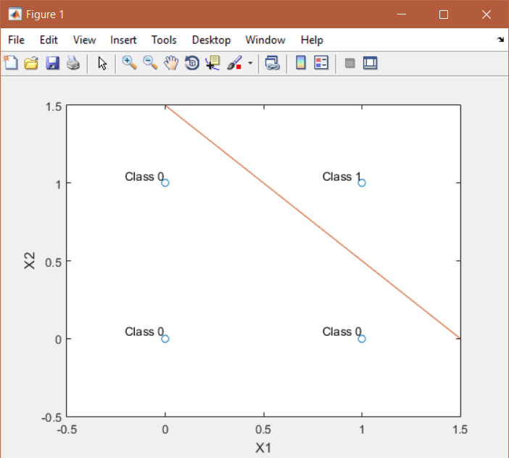
AND Problem
How about a line?
We call anything below the line 0, anything above 1. Easy!
This line was drawn with f(x) = -x + 1.5 …
This doesn’t help us much… what we want is in three dimensions: X1, X2 and a function F(X1, X2)
So how do we take this line and get two classes from it?
Class 1 space
Class 0 space

Slide 8
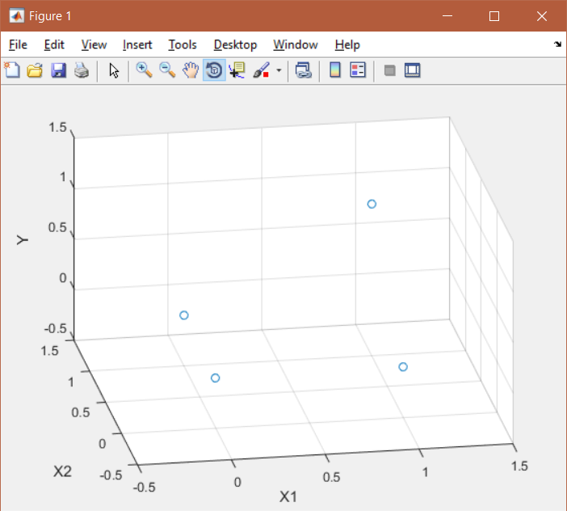
AND Problem
Here is how we can view the space
Let’s instead make a plane

Slide 9
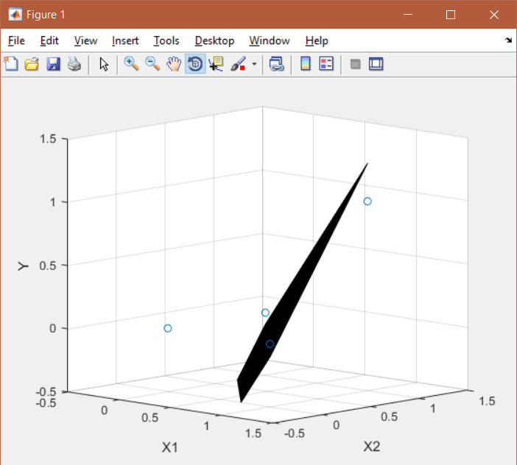
AND Problem
With some fiddling around, we can get an equation for a plane that separates the points again
f(x1, x2) = 1.4*x1 + 1.4*x2 – 1.5
This makes sense if you think about it
This is almost helpful, but we don’t have two classes… we have infinite outputs for infinite inputs
Notice: f(x) is negative for all class 0 points, and it is positive for all class 1 points

Slide 10
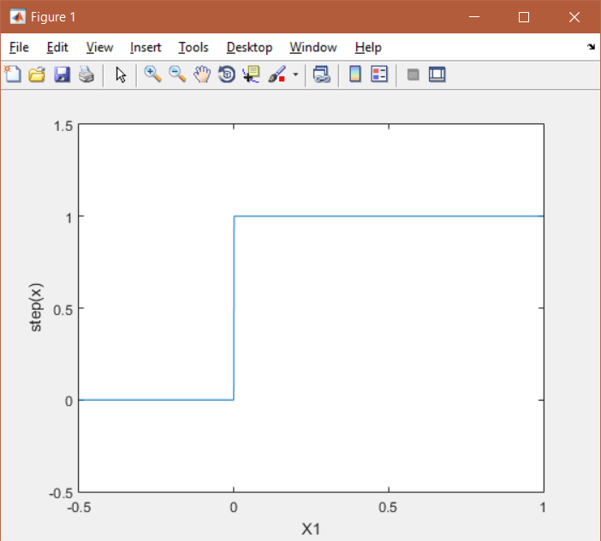
Step Function
Let me introduce you to: step function
if (x < 0):
return 0
Else:
return 1
How does this help us?
All negative numbers become 0, all positive numbers become 1

Slide 11
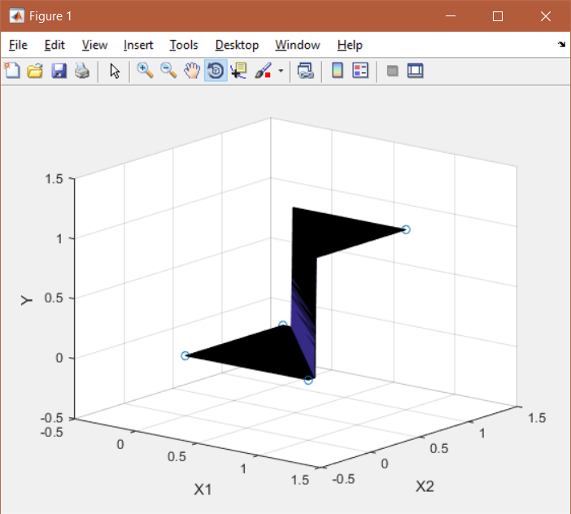
Step Function
Tadaa!
So, how does this all relate to neural nets?
Surprise: we just built one!

Slide 12
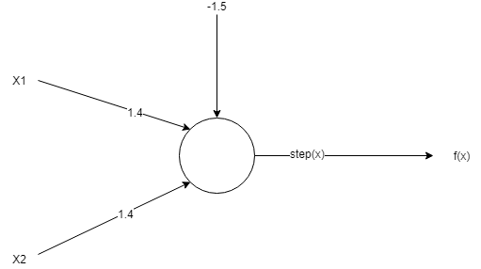

Perceptron
Tadaa!
So, how does this all relate to neural nets?
Surprise: we just built one!
Well, one neuron anyway
Well, one perceptron* anyway
Perceptron due to use of step()

Slide 13
Details again
f(x1, x2) = 1.4*x1 + 1.4*x2 – 1.5
Issue: Outputs infinite range of numbers
But: class 0 outputs are negative, class 1 outputs are positive

Slide 14
Details again
Step function turns output into 1 or 0

Slide 15

XOR Problem
Let’s look at a more complex problem
One line no longer works
This is the XOR problem and is famous for proving neural networks as a nonlinear classifier
How many neurons can we use to solve this problem?

Slide 16
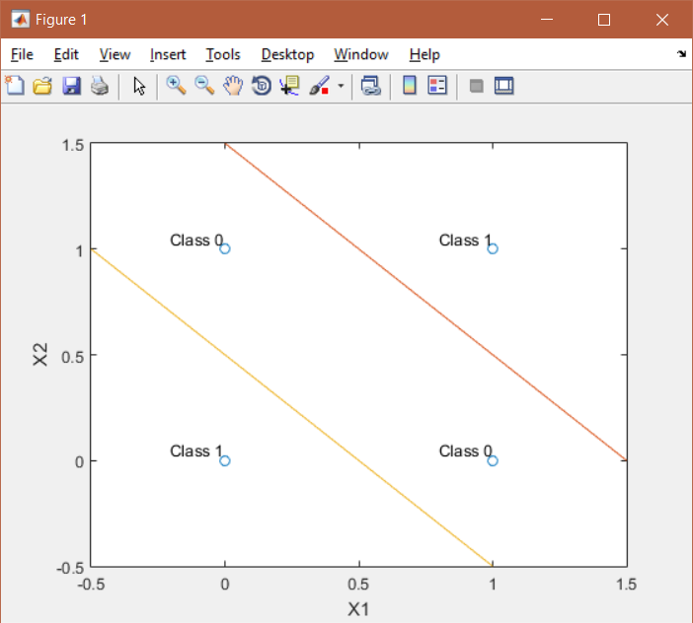
XOR Problem
If each neuron draws exactly one line, then the picture to the right requires two neurons
But again, this doesn’t solve our problem
We just have two neurons that each give an output
To solve, we need a third neuron that takes the output of the first two and gives the final output
This is how we get networks from neurons

Slide 17
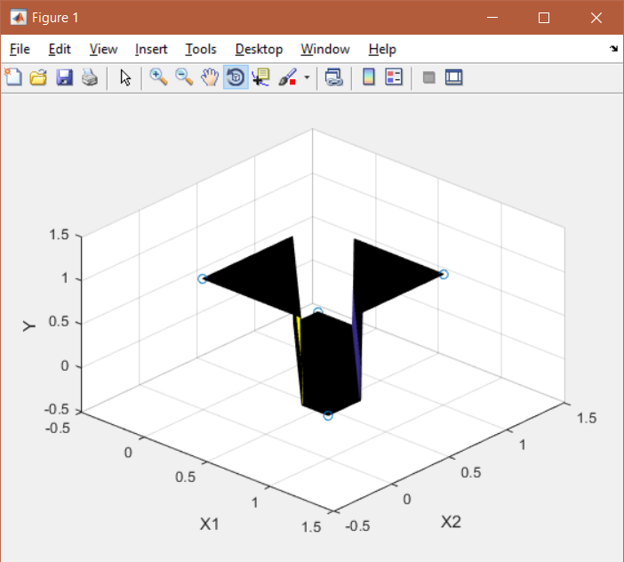
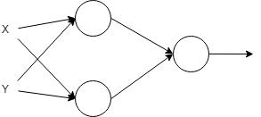
XOR Problem
This is what the output of the 3-neuron network looks like

Slide 18
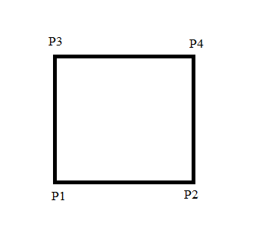
Robot Problem
Let’s look at a final problem
This was a problem on an exam I had (in a 6000 level class) (most people got it wrong)!
Imagine we have a robot and we want to build a neural net with one output, whether or not it is inside the box to the right
We know P1, P2, P3, P4, the coordinates of the box, and of course the coordinates of the robot
How many neurons do we need, and what does the network look like?

Slide 19
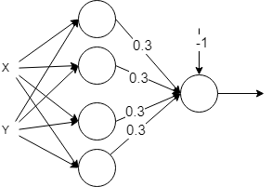
Robot Problem
5 neurons: one for each “line”
One final neuron to wrap it all up!
Can you see how the weights work?

Slide 20
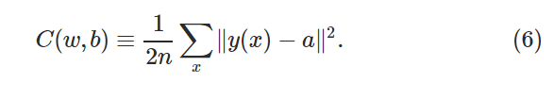
How do we find weights?
So how do we find the weights for the network?
Weeeellll…. It’s complicated
We must define a “loss” function (fitness, cost, objective, etc)
This is a function we will minimize in order to find the weights
From neuralnetworksanddeeplearning, Mean Squared Error :
For weights and biases (w,b), number of points n, ideal output y given input x, and actual output a

Slide 21
How do we find weights?
Forget the ugly equation and think of this
Say we have some function that says how wrong we are compared to the answer
If we minimize this function, we are the least wrong!

Slide 22
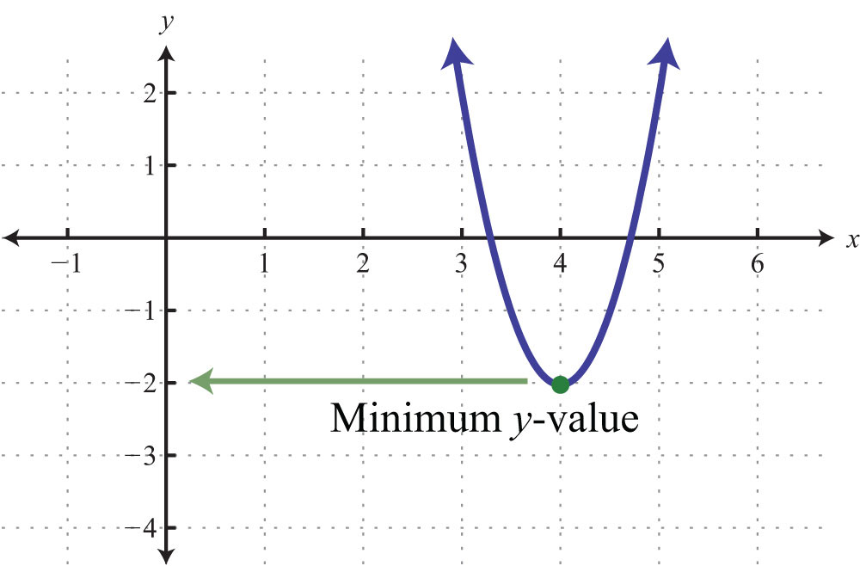
Minimization
So how do we minimize?
Anyone remember calc 1?
Take the derivative and set it = 0, easy!
https://saylordotorg.github.io/text_elementary-algebra/s12-05-graphing-parabolas.html

Slide 23
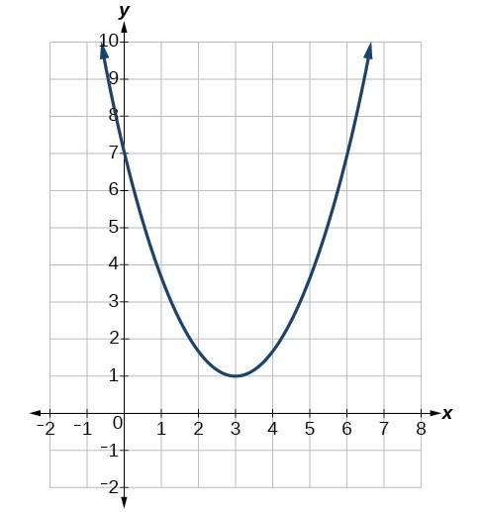
Minimization
….. What if there are 500,000 weights to take the derivative of?
Taking the derivative is no longer an option
Instead, we perform a nonlinear optimization using Gradient Descent
Through backpropogation, we can approximate the derivative (and it’s direction) at a certain point
Then, we can use that info to inch towards a minimum

Slide 24
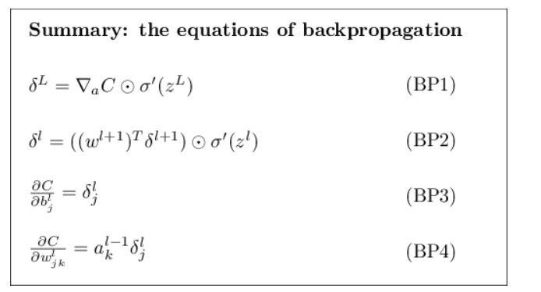
Backpropogation
Great, so what is backpropogation?
Weeeellll…. (from neuralnetworksanddeeplearning)
I strongly encourage you all to read the book, but we don’t have time today
For now, let’s do a short demo on how to use Keras!

Slide 25
Terms before workshop
Dataset = the data you’re training on
Batch size = number of points processed at one time
Epochs = number of times to go through entire dataset
Loss function = function used to judge how the network performs and train from that info
Keras = library we will use
Tensorflow = backend to Keras (RIP Theano)

Slide 26
Instructions for getting started
Go to: https://github.com/santacml/Keras_Talk_IEEE
Look up “santacml github” and go to repo “Keras_Talk_IEEE”
Download “Keras_Workshop.ipynb” from the repo (no need to clone the whole thing)
Click on the file
Click “raw”
Copy paste into a file, or right click and save
Navigate to: https://colab.research.google.com
Can look up “colab start project”
Click on “New Python 3 Notebook”
Click on File->Upload notebook… -> Choose file you just downloaded
Done!

